Slide 1
Integration & Differentiation

Slide 2
Session 18 :
Numerical Integration
The Trapezoidal Rule
Simpson’s Rules
Gauss Quadrature
Numerical Differentiation

Slide 3
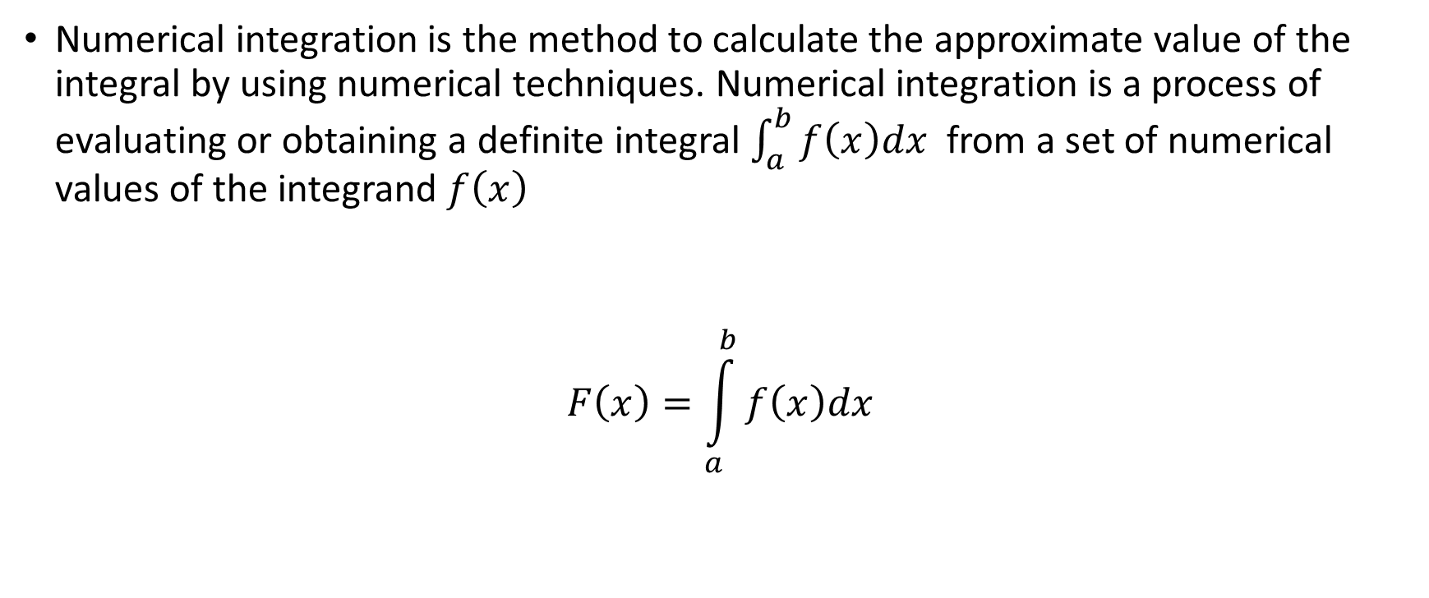
Numerical Integration
Numerical integration is the method to calculate the approximate value of the integral by using numerical techniques. Numerical integration is a process of evaluating or obtaining a definite integral $\int_{a}^{b}{f\left(x\right)dx}$ from a set of numerical values of the integrand $f\left(x\right)$
$$F\left(x\right)=\int_{a}^{b}{f\left(x\right)dx}$$

Slide 4
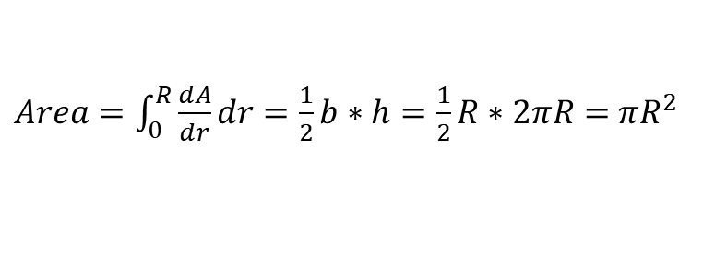
Numerical Integration
r
R
2πR
2πR
dr
Smaller dr
Length = 2πr
0
R
0
R
Trapezoidal ≈ Rectangle with small dr
$Area=\int_{0}^{R}{\frac{dA}{dr}dr}=\frac{1}{2}b∗h=\frac{1}{2}R∗2πR=$ $πR^{2}$
dA=Area ≈ 2πr*dr

Slide 5

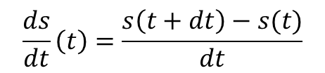
What is Derivative ?
s
Distance travel (s)
$$\frac{ds}{dt}\left(t\right)=\frac{s\left(t+dt\right)−s(t)}{dt}$$
ds/dt
velocity
t

Slide 6
Reference
https://www.youtube.com/watch?v=rfG8ce4nNh0
“The essence of calculus” by 3Blue1Brown

Slide 7
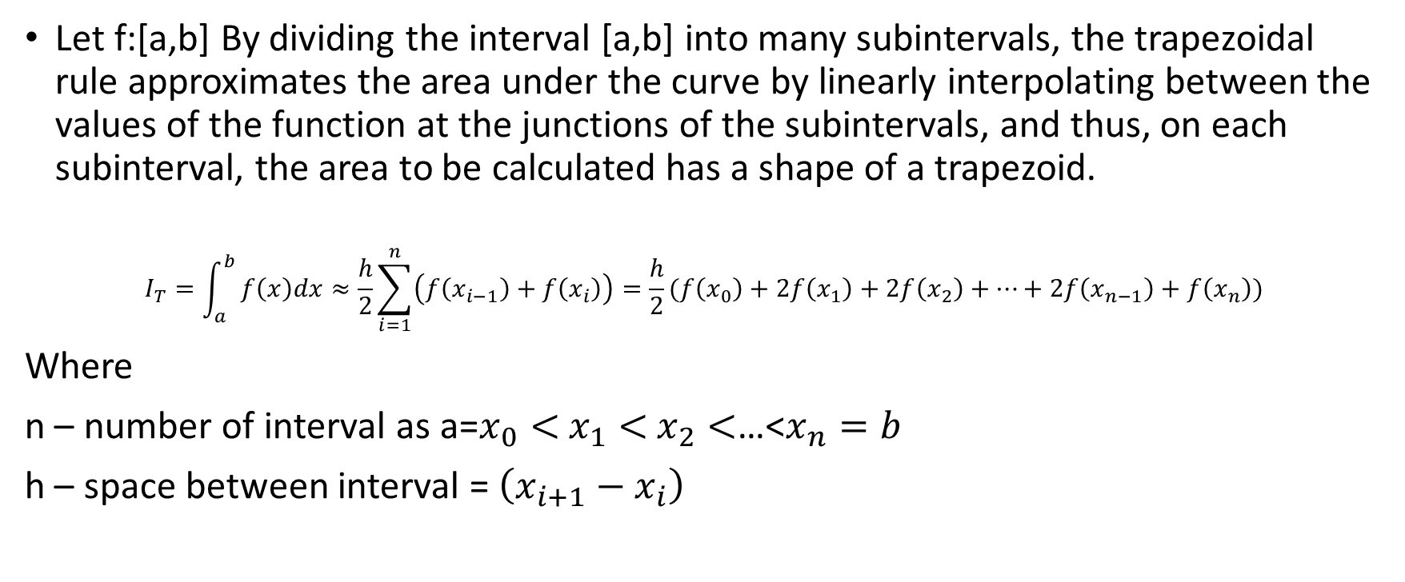
The Trapezoidal Rule
Let f:[a,b] By dividing the interval [a,b] into many subintervals, the trapezoidal rule approximates the area under the curve by linearly interpolating between the values of the function at the junctions of the subintervals, and thus, on each subinterval, the area to be calculated has a shape of a trapezoid.
$$I_{T}=\int_{a}^{b}{f\left(x\right)dx≈\frac{h}{2}\sum_{i=1}^{n}{\left(f\left(x_{i−1}\right)+f\left(x_{i}\right)\right)=\frac{h}{2}(f\left(x_{0}\right)+2f\left(x_{1}\right)+2f\left(x_{2}\right)+…+2f\left(x_{n−1}\right)+f\left(x_{n}\right))}}$$
Where
n – number of interval as a=$x_{0}<$ $x_{1}<$ $x_{2}<$…<$x_{n}=b$
h – space between interval = $\left(x_{i+1}−x_{i}\right)$

Slide 8
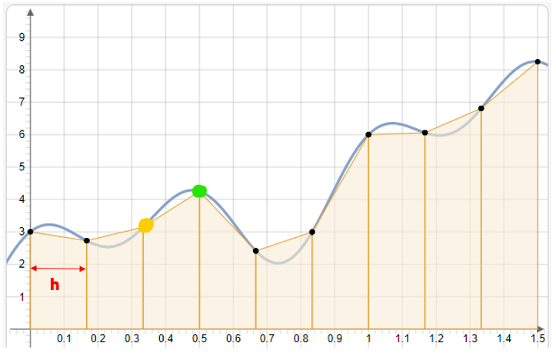

The Trapezoidal Rule
$$I_{T}=\int_{a}^{b}{f\left(x\right)dx≈\frac{h}{2}\sum_{i=1}^{n}{\left(f\left(x_{i−1}\right)+f\left(x_{i}\right)\right)}}$$
n=9
h=0.5-0.32=0.18

Slide 9
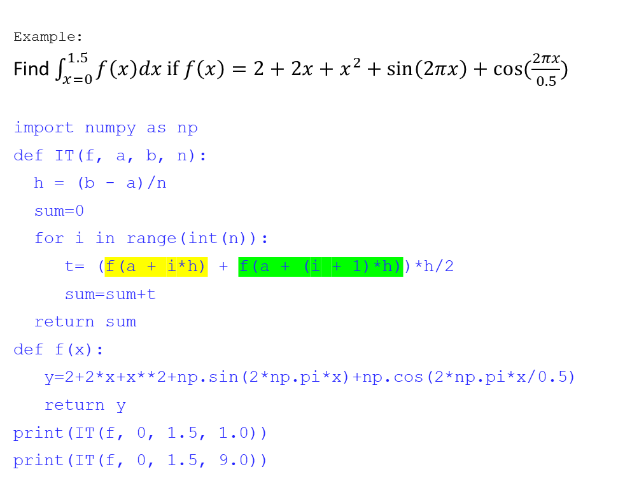
The Trapezoidal Rule
Example:
Find $\int_{x=0}^{1.5}{f\left(x\right)dx if f\left(x\right)=2+2x+x^{2}+\sin\left(2πx\right)+cos⁡(\frac{2πx}{0.5})}$
import numpy as np
def IT(f, a, b, n):
h = (b - a)/n
sum=0
for i in range(int(n)):
t= (f(a + i*h) + f(a + (i + 1)*h))*h/2
sum=sum+t
return sum
def f(x):
y=2+2*x+x**2+np.sin(2*np.pi*x)+np.cos(2*np.pi*x/0.5)
return y
print(IT(f, 0, 1.5, 1.0))
print(IT(f, 0, 1.5, 9.0))

Slide 10
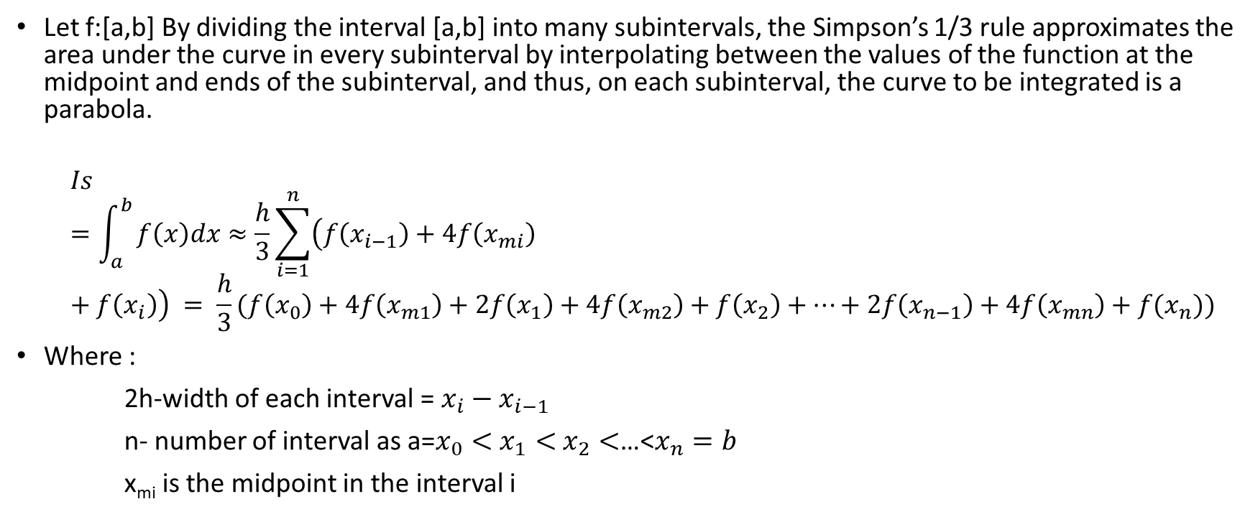
Simpson’s ⅓ Rules
Let f:[a,b] By dividing the interval [a,b] into many subintervals, the Simpson’s 1/3 rule approximates the area under the curve in every subinterval by interpolating between the values of the function at the midpoint and ends of the subinterval, and thus, on each subinterval, the curve to be integrated is a parabola.
$$Is=\int_{a}^{b}{f\left(x\right)dx≈\frac{h}{3}\sum_{i=1}^{n}{\left(f\left(x_{i−1}\right)+4f\left(x_{mi}\right)+f\left(x_{i}\right)\right)} = \frac{h}{3}(f\left(x_{0}\right)+4f\left(x_{m1}\right)+2f\left(x_{1}\right)+4f\left(x_{m2}\right)+f\left(x_{2}\right)+…+2f\left(x_{n−1}\right)+4f\left(x_{mn}\right)+f(x_{n}))}$$
Where :
2h-width of each interval = ${x_{i}−x}_{i−1}$
n- number of interval as a=$x_{0}<$ $x_{1}<$ $x_{2}<$…<$x_{n}=b$
x_{mi} is the midpoint in the interval i

Slide 11
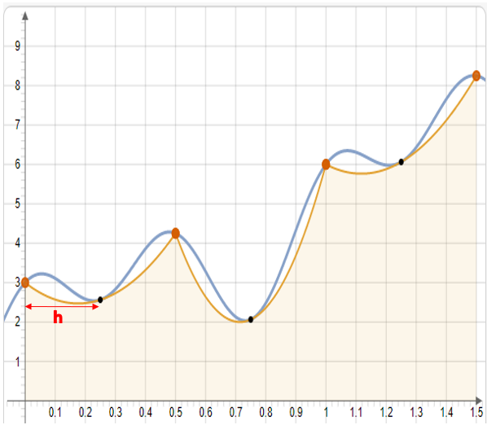

Simpson’s ⅓ Rules
$\frac{h}{3}(f\left(x_{0}\right)+4f\left(x_{m1}\right)+2f\left(x_{1}\right)$+…+

Slide 12
Simpson’s ⅓ Rules
import numpy as np
def IS1(f, a, b, n):
h = ((b - a)/n)/2
sum=0
for i in range(int(n)) :
t=(f(a + (2*i)*h) + 4*f(a + (2*i + 1)*h) + f(a + (2*i + 2)*h))
sum=sum + t
return h/3*sum
def f(x):
y=2 + 2*x + x**2 + np.sin(2*np.pi*x) + np.cos(2*np.pi*x/0.5)
return y
print(IS1(f, 0, 1.5, 1.0))
print(IS1(f, 0, 1.5, 3.0))
print(IS1(f, 0, 1.5, 18.0))

Slide 13
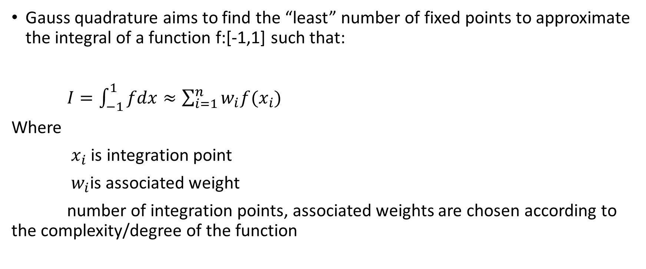
Gauss Quadrature
Gauss quadrature aims to find the “least” number of fixed points to approximate the integral of a function f:[-1,1] such that:
$I=\int_{−1}^{1}{fdx≈\sum_{i=1}^{n}{w_{i}{f(x}_{i})}}$
Where
$x_{i}$ is integration point
$w_{i}$is associated weight
number of integration points, associated weights are chosen according to the complexity/degree of the function

Slide 14
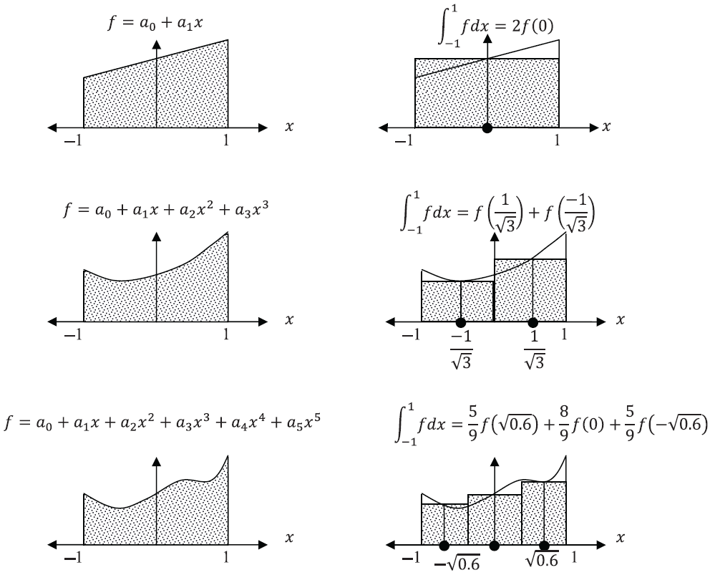
Gauss Quadrature
1 Degree Poly => 2n-1=1 => n=1 point
3 Degree Poly => 2n-1=3 => n=2 point
5 Degree Poly => 2n-1=5 => n=3 point

Slide 15
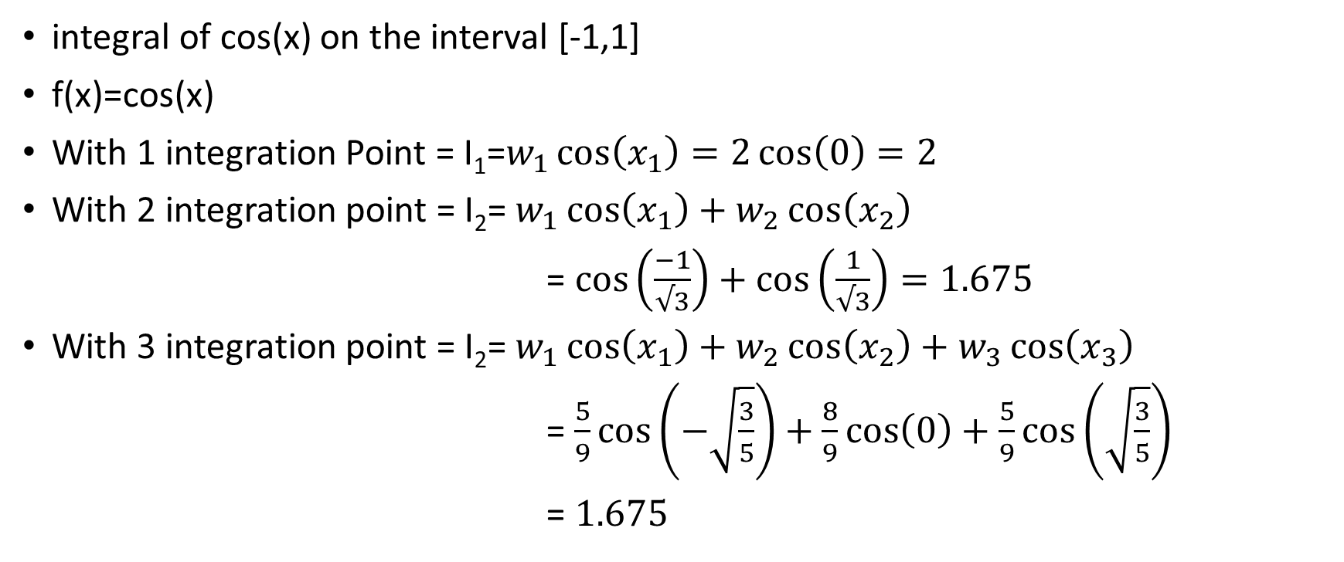
Gauss Quadrature Example
integral of cos(x) on the interval [-1,1]
f(x)=cos(x)
With 1 integration Point = I₁=$w_{1}\cos\left(x_{1}\right)=2\cos\left(0\right)=2$
With 2 integration point = I₂= $w_{1}\cos\left(x_{1}\right)+w_{2}\cos\left(x_{2}\right)$
= $\cos\left(\frac{−1}{√3}\right)+\cos\left(\frac{1}{√3}\right)=1.675$
With 3 integration point = I₂= $w_{1}\cos\left(x_{1}\right)+w_{2}\cos\left(x_{2}\right)+w_{3}\cos\left(x_{3}\right)$
= $\frac{5}{9}\cos\left(−\sqrt{\frac{3}{5}}\right)+\frac{8}{9}\cos\left(0\right)+\frac{5}{9}\cos\left(\sqrt{\frac{3}{5}}\right)$
= $1.675$

Slide 16
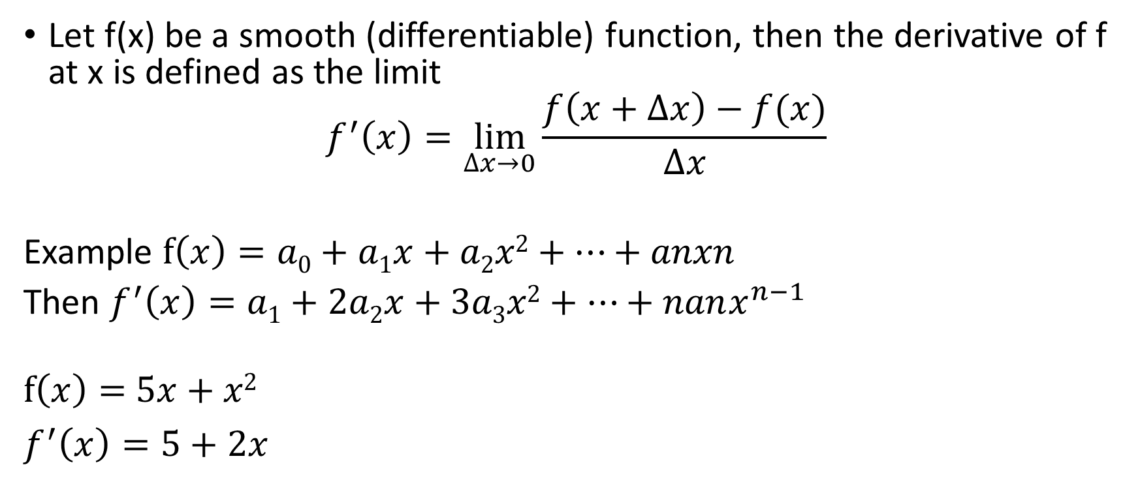
Numerical Differentiation
Let f(x) be a smooth (differentiable) function, then the derivative of f at x is defined as the limit
$$f^{′}\left(x\right)=\lim_{∆x→0}{\frac{f\left(x+∆x\right)−f(x)}{∆x}}$$
Example $f\left(x\right)=a0+a1x+a2x2+…+anxn$
Then $f^{′}\left(x\right)=a1+2a2x+3a3x2+…+nanx^{n−1}$
$f\left(x\right)=$ $5x+x2$
$f^{′}\left(x\right)=5+2x$

Slide 17
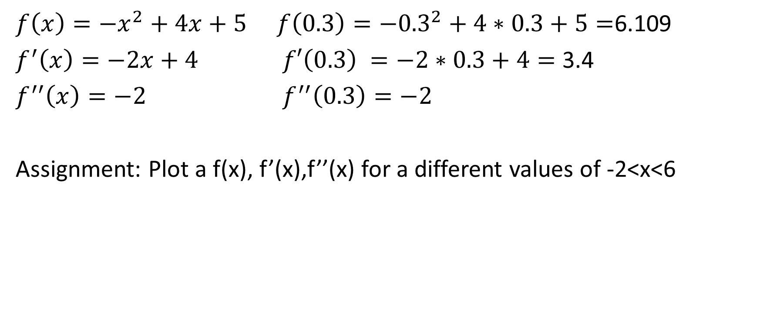
Numerical Differentiation
$f\left(x\right)=−x^{2}+4x+5$ $f\left(0.3\right)=−{0.3}^{2}+4∗0.3+5=$6.109
$f^{′}\left(x\right)=−2x+4$ $f′\left(0.3\right) =−2∗0.3+4=$ 3.4
$f^{′′}\left(x\right)=−2$ $f^{′′}\left(0.3\right)=−2$
Assignment: Plot a f(x), f’(x),f’’(x) for a different values of -2<x<6

Slide 18
Session 19 : Differential Equations
Numerical solution of ordinary differential equations
Euler’s Method
Improvements of Euler’s Method
Runge-Kutta Methods
Adaptive Runge-Kutta Methods

Slide 19
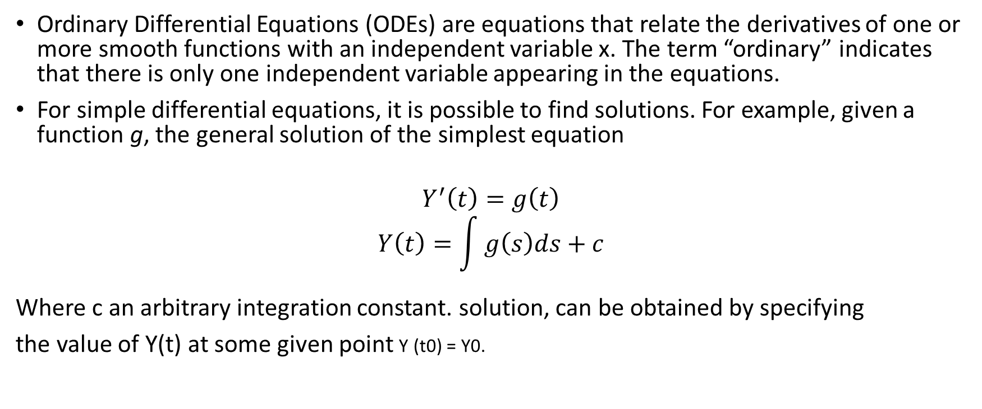
Numerical solution of ordinary differential equations
Ordinary Differential Equations (ODEs) are equations that relate the derivatives of one or more smooth functions with an independent variable x. The term “ordinary” indicates that there is only one independent variable appearing in the equations.
For simple differential equations, it is possible to find solutions. For example, given a function g, the general solution of the simplest equation
$$Y^{′}\left(t\right)=g\left(t\right)$$
$$Y\left(t\right)=\int{g\left(s\right)ds+c}$$
Where c an arbitrary integration constant. solution, can be obtained by specifying
the value of Y(t) at some given point Y (t0) = Y0.

Slide 20
Numerical solution of ordinary differential equations
Numerical solution may be given using any of the following methodologies:
Taylor series method
Picard’s method
Euler's method
Modified Euler’s method
Runge-Kutta method
Milne’s Predictor corrector method
Adams-Bashforth method

Slide 21
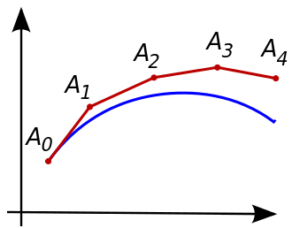
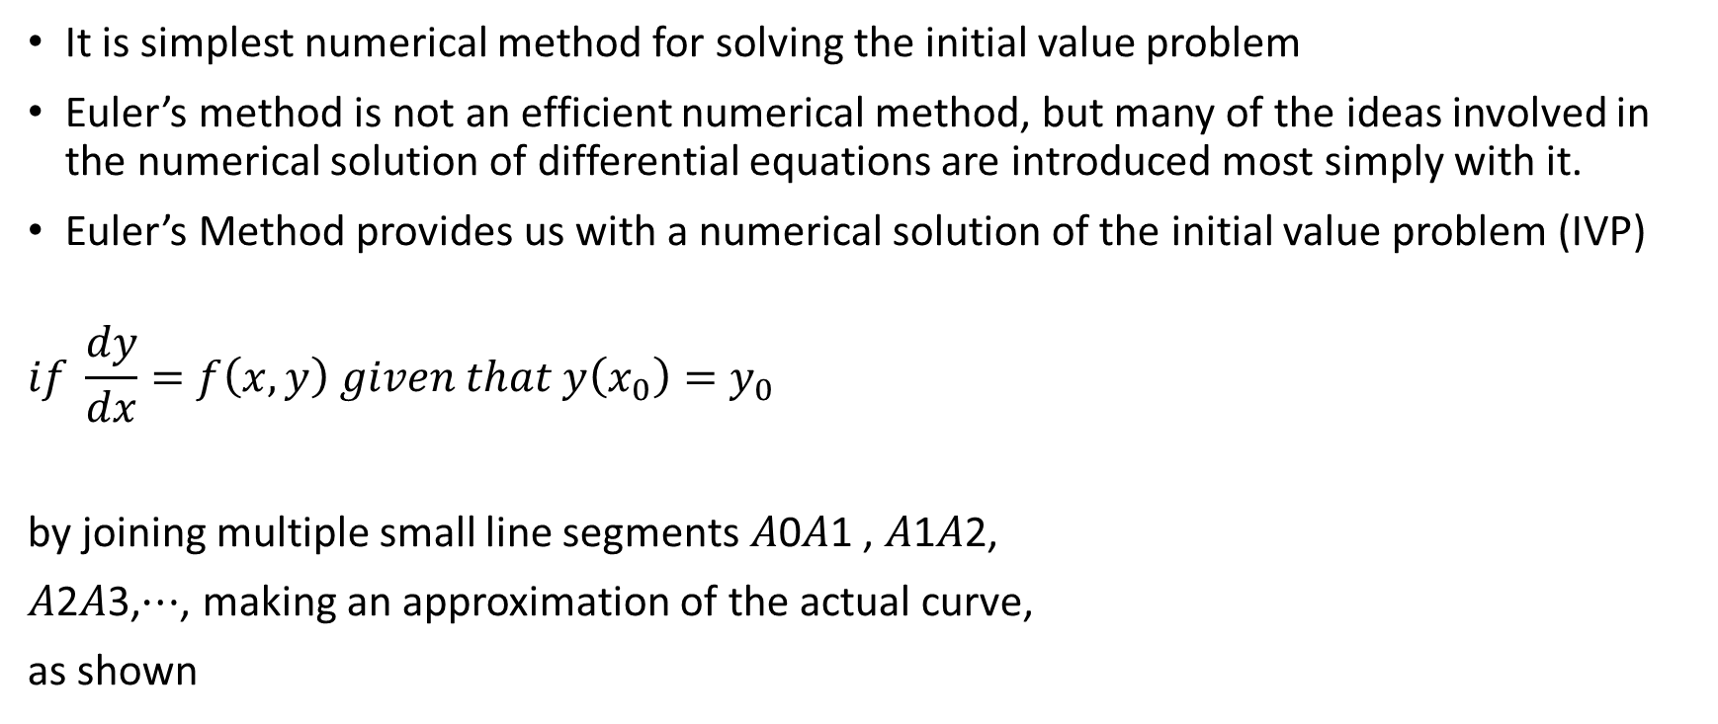
Euler's method
It is simplest numerical method for solving the initial value problem
Euler’s method is not an efficient numerical method, but many of the ideas involved in the numerical solution of differential equations are introduced most simply with it.
Euler’s Method provides us with a numerical solution of the initial value problem (IVP)
$$if \frac{dy}{dx}=f\left(x,y\right) given that y\left(x_{0}\right)=y_{0}$$
by joining multiple small line segments 𝐴0𝐴1 , 𝐴1𝐴2,
𝐴2𝐴3,⋯, making an approximation of the actual curve,
as shown

Slide 22
Euler's method
Thus if 𝑥₀,𝑥₁ is the small interval, where 𝑥₁=𝑥₀+ℎ, we approximate the curve by the tangent drawn to curve at point 𝐴₀ , having coordinates 𝑥₀,𝑦₀ , whose equation is given by 𝑦−𝑦₀=𝑚(𝑥−𝑥₀) , where 𝑚 is slope of tangent at the point 𝑥₀,𝑦₀ and ℎ is a small interval
So by Euler’s method says
𝑦_{𝑛}=𝑦_{𝑛−1}+ℎ𝑓(𝑥_{𝑛−1},𝑦_{𝑛−1})

Slide 23
Euler's method
Example: Using Euler’s method, Compute 𝑦(0.12) for the initial value problem: 𝑑𝑦/𝑑𝑥=𝑥³+𝑦 ; 𝑦(0)=1 , taking ℎ=0.02
Solution: Given 𝑓(𝑥,𝑦)= 𝑥³+𝑦 , 𝑥₀=0, 𝑦₀=1, 𝑥_{𝑛}=𝑥_{𝑛−1}+ℎ , ℎ=0.02
∴ 𝑥₁=0.02 , 𝑥₂=0.04 , 𝑥₃=0.06 , 𝑥₄=0.08 , 𝑥₅=0.1, 𝑥₆=0.12
Using Euler’s method 𝑦_{𝑛}=𝑦_{𝑛−1}+ℎ𝑓(𝑥_{𝑛−1},𝑦_{𝑛−1})
⇒ 𝑦_{𝑛}=𝑦_{𝑛−1}+ℎ(𝑥_{𝑛−1}³+𝑦_{𝑛−1})
Put 𝑛=1, 𝑦₁=𝑦(0.02) =𝑦₀+ℎ(𝑥₀³+y₀) , ∴ 𝑦₁=1+0.02 (0+1) =1.02
Put 𝑛=2, 𝑦₂=𝑦(0.04) =𝑦₁+ℎ(𝑥₁³+𝑦₁), ∴ 𝑦₂=1.02+0.02((0.02)³+1.02) =1.04040016
Put 𝑛=3, 𝑦₃=𝑦(0.06) =𝑦₂+ℎ (𝑥₂³+𝑦₂), ∴ 𝑦₃=1.04040016 +0.02((0.04)³+1.04040016) =1.061209443
Put 𝑛=4, 𝑦₄=𝑦(0.08) =𝑦₃+ℎ (𝑥₃³+𝑦₃), ∴ 𝑦₄=1.061209443 +0.02((0.06)³+1.061209443)=1.082437952
Put 𝑛=5, 𝑦₅=𝑦(0.1) =𝑦₄+ℎ(𝑥₄³+𝑦₄), ∴ 𝑦₅=1.082437952 +0.02((0.08)³+1.082437952) =1.104096951
Put 𝑛=6, 𝑦⁶=𝑦(0.12) =𝑦₅+ℎ(𝑥₅³+𝑦₅), ∴ 𝑦₆=1.104096951 +0.02((0.1)³+1.104096951) =1.126198890
Thus at 𝑥=0.12, 𝑦=1.126198890 ⇒𝑦(0.12) =1.126198890

Slide 24
Euler's method
Assignment : Write a python program to compute 𝑦(0.12) for the initial value problem: 𝑑𝑦/𝑑𝑥=𝑥³+𝑦 ; 𝑦₀ =1 , taking ℎ=0.02

Slide 25
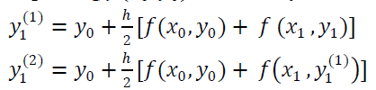

Modified Euler’s Method
Though Euler's method is quite easy to implement, but unless the step size ℎ is very small, the truncation error will be large, and the results will be inaccurate.
As per Modified Euler's method, a better approximation of 𝑦₁ is given by improving 𝑓(𝑥₀,𝑦₀) obtained by Euler's method as below
Continue approximating 𝑦₁ until two consecutive values are coincident to a specific degree of accuracy.
Repeat the procedure for 𝑦₂ , 𝑦₃, 𝑦₄… to find 𝑦_{𝑛}

Slide 26
Modified Euler’s Method
Use Modified Euler’s method to obtain 𝑦(0.2) correct to 3 decimal places, given that 𝑑𝑦/𝑑𝑥=𝑦−𝑥² ; 𝑦₀ =1
Solution: Given 𝑓(𝑥,𝑦)=𝑦−𝑥² , 𝑥₀=0, 𝑦₀=1
By Euler’s method 𝑦_{𝑛}=𝑦_{𝑛−1}+ℎ𝑓(𝑥_{𝑛−1},𝑦_{𝑛−1})
To evaluate 𝑦(0.2) , ℎ=0.2, 𝑥₁=0+0.2=0.2
𝑦₁=𝑦(0.2) =𝑦₀+ℎ𝑓(𝑥₀,𝑦₀),
𝑓(𝑥₀,𝑦₀)=𝑦₀ −𝑥₀²=1−0=1
∴ 𝑦₁=1+0.2(1)=1.2
𝑓(𝑥₁,𝑦₁)=𝑦₁ −𝑥₁²=1.2−(0.2)²=1.16
using Modified Euler’s method
𝑦₁⁽¹⁾=𝑦₀+(ℎ/2)(𝑓(𝑥₀,𝑦₀)+ 𝑓(𝑥₁ ,𝑦₁))
𝑦₁⁽¹⁾=1 +(0.2/2)(1+1.16) =1.216
𝑓(𝑥₁ ,𝑦₁⁽¹⁾)=𝑦₁⁽¹⁾−𝑥₁²=1.216−(0.2)²=1.176
𝑦₁⁽²⁾=𝑦₀+(ℎ/2)[𝑓(𝑥 ₀,𝑦 ₀)+ 𝑓(𝑥₁ ,𝑦₁⁽¹⁾)]
𝑦₁⁽²⁾=1+(0.2/2)(1+1.176) =1.2176
𝑓(𝑥₁ ,𝑦₁⁽²⁾)=𝑦₁⁽²⁾−𝑥₁²=1.2176−(0.2)²=1.1776
𝑦₁⁽³⁾=𝑦₀+(ℎ/2)[𝑓(𝑥₀,𝑦₀)+ 𝑓(𝑥₁ ,𝑦₁⁽²⁾)]
𝑦₁⁽³⁾=1+(0.2/2)(1+1.1776)=1.21776=𝑦(0.2)

Slide 27
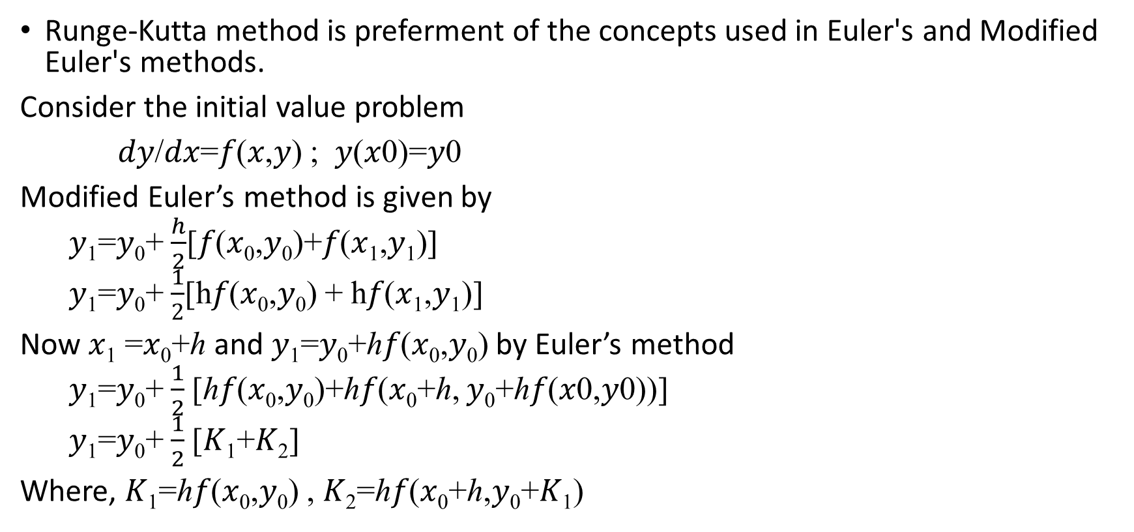
Runge-Kutta’s Method
Runge-Kutta method is preferment of the concepts used in Euler's and Modified Euler's methods.
Consider the initial value problem
𝑑𝑦/𝑑𝑥=𝑓(𝑥,𝑦) ; 𝑦(𝑥0)=𝑦0
Modified Euler’s method is given by
𝑦₁=𝑦₀+$\frac{h}{2}$[𝑓(𝑥₀,𝑦₀)+𝑓(𝑥₁,𝑦₁)]
𝑦₁=𝑦₀+$\frac{1}{2}$[h𝑓(𝑥₀,𝑦₀) + h𝑓(𝑥₁,𝑦₁)]
Now 𝑥₁ =𝑥₀+ℎ and 𝑦₁=𝑦₀+ℎ𝑓(𝑥₀,𝑦₀) by Euler’s method
𝑦₁=𝑦₀+$\frac{1}{2}$[ℎ𝑓(𝑥₀,𝑦₀)+ℎ𝑓(𝑥₀+ℎ, 𝑦₀+ℎ𝑓(𝑥0,𝑦0))]
𝑦₁=𝑦₀+$\frac{1}{2}$[𝐾₁+𝐾₂]
Where, 𝐾₁=ℎ𝑓(𝑥₀,𝑦₀) , 𝐾₂=ℎ𝑓(𝑥₀+ℎ,𝑦₀+𝐾₁)

Slide 28
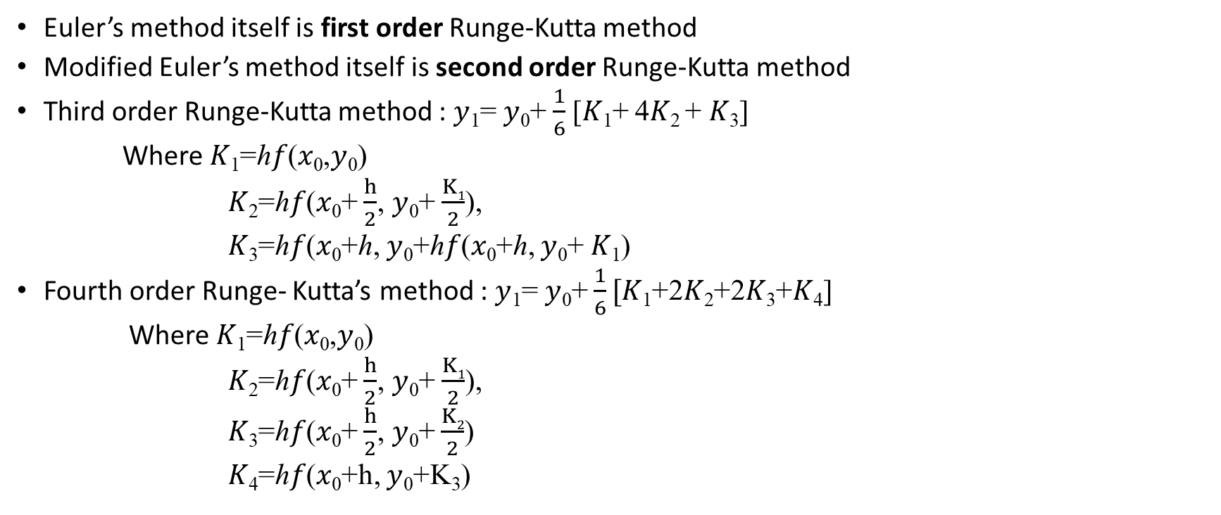
Runge-Kutta’s Method
Euler’s method itself is first order Runge-Kutta method
Modified Euler’s method itself is second order Runge-Kutta method
Third order Runge-Kutta method : 𝑦₁= 𝑦₀+$\frac{1}{6}$[𝐾₁+ 4𝐾₂ + 𝐾₃]
Where 𝐾₁=ℎ𝑓(𝑥₀,𝑦₀)
𝐾₂=ℎ𝑓(𝑥₀+ $\frac{h}{2}$, 𝑦₀+ $\frac{K1}{2}$),
𝐾₃=ℎ𝑓(𝑥₀+ℎ, 𝑦₀+ℎ𝑓(𝑥₀+ℎ, 𝑦₀+ 𝐾₁)
Fourth order Runge- Kutta’s method : 𝑦₁= 𝑦₀+ $\frac{1}{6}[$𝐾₁+2𝐾₂+2𝐾₃+𝐾₄]
Where 𝐾₁=ℎ𝑓(𝑥₀,𝑦₀)
𝐾₂=ℎ𝑓(𝑥₀+ $\frac{h}{2}$, 𝑦₀+ $\frac{K1}{2}$),
𝐾₃=ℎ𝑓(𝑥₀+ $\frac{h}{2}$, 𝑦₀+ $\frac{K2}{2}$)
𝐾₄=ℎ𝑓(𝑥₀+h, 𝑦₀+K₃)
Runge-Kutta’s Method

Slide 29
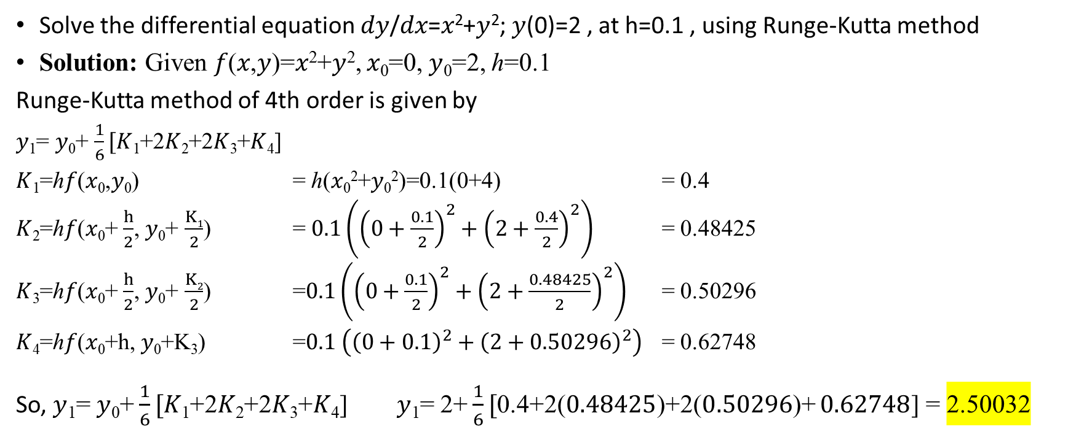
Runge-Kutta’s Method
Solve the differential equation 𝑑𝑦/𝑑𝑥=𝑥²+𝑦²; 𝑦(0)=2 , at h=0.1 , using Runge-Kutta method
Solution: Given 𝑓(𝑥,𝑦)=𝑥²+𝑦², 𝑥₀=0, 𝑦₀=2, ℎ=0.1
Runge-Kutta method of 4th order is given by
𝑦₁= 𝑦₀+ $\frac{1}{6}[$𝐾₁+2𝐾₂+2𝐾₃+𝐾₄]
𝐾₁=ℎ𝑓(𝑥₀,𝑦₀) = ℎ(𝑥₀²+𝑦₀²)=0.1(0+4) = 0.4
𝐾₂=ℎ𝑓(𝑥₀+ $\frac{h}{2}$, 𝑦₀+ $\frac{K1}{2}$) = $0.1\left({\left(0+\frac{0.1}{2}\right)}^{2}+{\left(2+\frac{0.4}{2}\right)}^{2}\right)$ = 0.48425
𝐾₃=ℎ𝑓(𝑥₀+ $\frac{h}{2}$, 𝑦₀+ $\frac{K2}{2}$) =$0.1\left({\left(0+\frac{0.1}{2}\right)}^{2}+{\left(2+\frac{0.48425}{2}\right)}^{2}\right)$ = 0.50296
𝐾₄=ℎ𝑓(𝑥₀+h, 𝑦₀+K₃) =$0.1 \left({\left(0+0.1\right)}^{2}+{\left(2+0.50296\right)}^{2}\right)$ = 0.62748
So, 𝑦₁= 𝑦₀+ $\frac{1}{6}[$𝐾₁+2𝐾₂+2𝐾₃+𝐾₄] 𝑦₁= 2+ $\frac{1}{6}[$0.4+2($0.48425$)+2($0.50296$)+ $0.62748$] = 2.50032

Slide 30
Adaptive Runge-Kutta Methods
In Runge-Kutta Methods we use fix interval as h to move along a f(x,y) where as in Adaptive Runge-Kutta Methods h is varies base on the solution we get from Runge-Kutta Methods.
Generally option used
Use original step = h
Half a step size = h/2-> compare values with h and h/2, if it is too large, use h/2
Double a step size = 2h-> compare values with h and 2h, if it is too small, use 2h

Slide 31
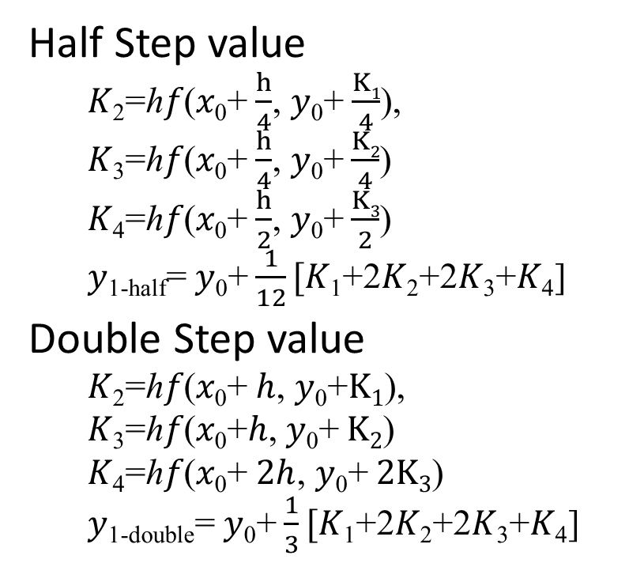
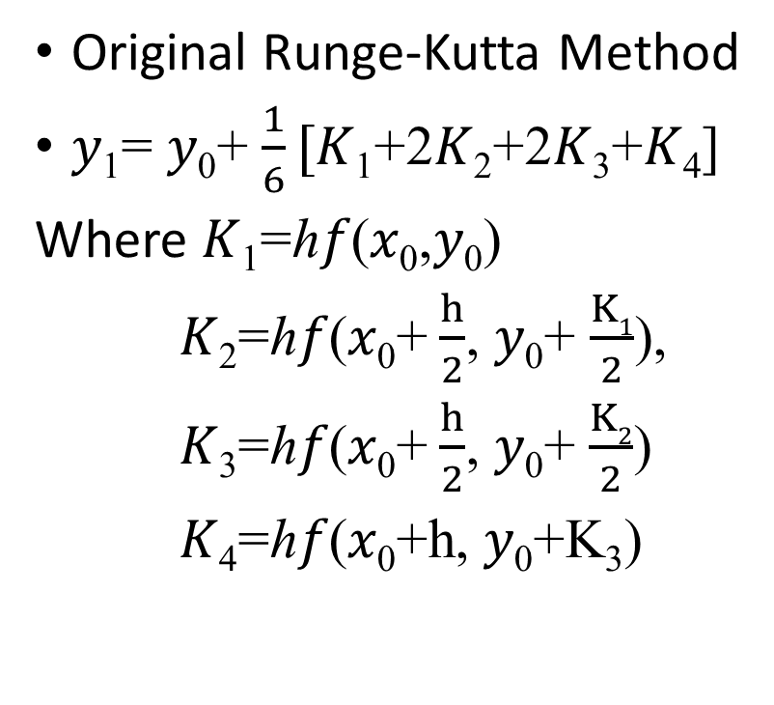
Adaptive Runge-Kutta Methods
Original Runge-Kutta Method
𝑦₁= 𝑦₀+ $\frac{1}{6}[$𝐾₁+2𝐾₂+2𝐾₃+𝐾₄]
Where 𝐾₁=ℎ𝑓(𝑥₀,𝑦₀)
𝐾₂=ℎ𝑓(𝑥₀+ $\frac{h}{2}$, 𝑦₀+ $\frac{K1}{2}$),
𝐾₃=ℎ𝑓(𝑥₀+ $\frac{h}{2}$, 𝑦₀+ $\frac{K2}{2}$)
𝐾₄=ℎ𝑓(𝑥₀+h, 𝑦₀+K₃)
Half Step value
𝐾₂=ℎ𝑓(𝑥₀+ $\frac{h}{4}$, 𝑦₀+ $\frac{K1}{4}$),
𝐾₃=ℎ𝑓(𝑥₀+ $\frac{h}{4}$, 𝑦₀+ $\frac{K2}{4}$)
𝐾₄=ℎ𝑓(𝑥₀+ $\frac{h}{2}$, 𝑦₀+ $\frac{K3}{2}$)
𝑦_{1-half}= 𝑦₀+ $\frac{1}{12}[$𝐾₁+2𝐾₂+2𝐾₃+𝐾₄]
Double Step value
𝐾₂=ℎ𝑓(𝑥₀+ $h$, 𝑦₀+$K1$),
𝐾₃=ℎ𝑓(𝑥₀+$h$, 𝑦₀+ $K2$)
𝐾₄=ℎ𝑓(𝑥₀+ $2h$, 𝑦₀+ $2K3$)
𝑦_{1-double}= 𝑦₀+ $\frac{1}{3}[$𝐾₁+2𝐾₂+2𝐾₃+𝐾₄]

Slide 32
Adaptive Runge-Kutta Methods
Assume
Max threshold = 0.01
Min threshold = 0.001
Calculate 𝑦₁ , 𝑦_{1-double} and 𝑦_{1-half}
If abs(𝑦₁ - 𝑦_{1-half})/abs(𝑦₁) > 0.01 then use h/2 for a next step
If abs(𝑦₁ - 𝑦_{1-double})/abs(𝑦₁) < 0.001 then use 2h for a next step

